Slide 1
Airline Review Analysis
Insights from Skytrax Reviews

Slide 2
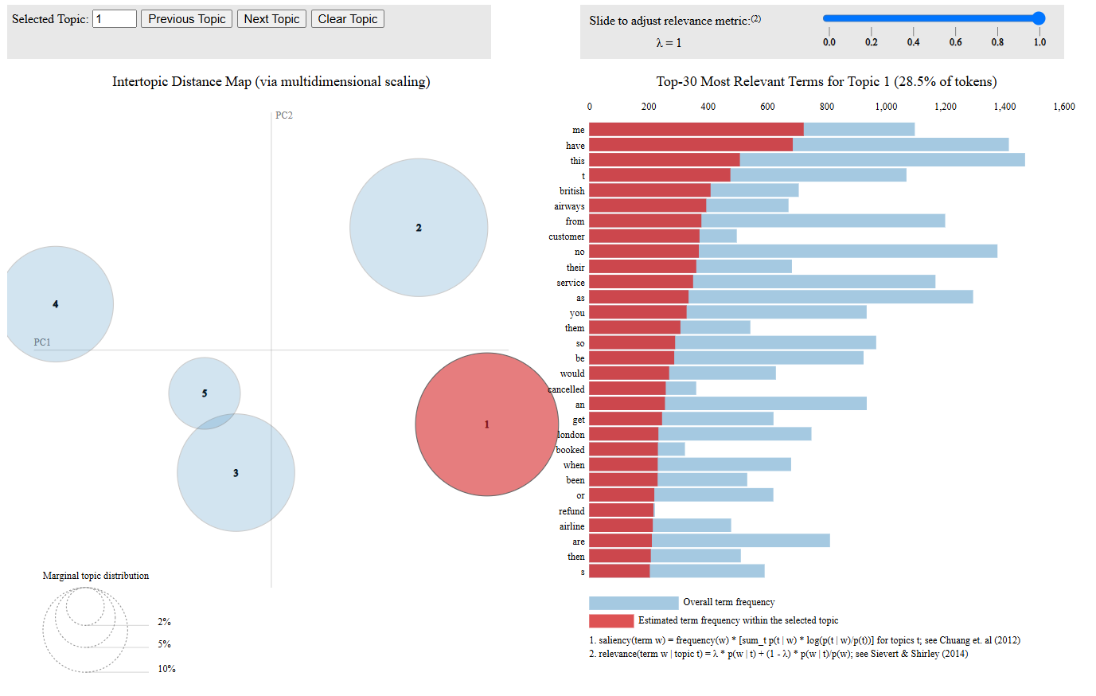
Providing insights on BA based on LDA Model
From topic one it seems close to 300/331 people asked for a refund.
Approximately 339/400 cancelled their flights.
With this findings, it reflects a bad performance from BA and therefore we need to work towards improving our services and the issues that may potentially lead to cancellations and requests of refunds.

